Slide 1
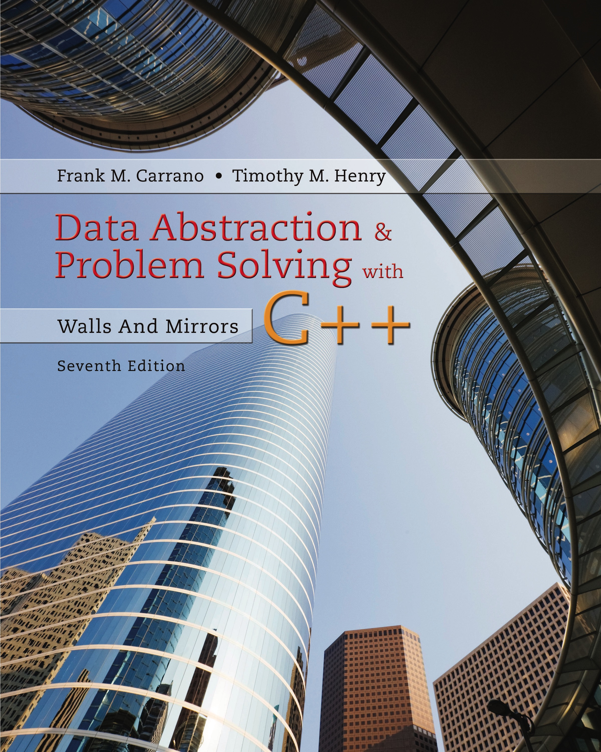
Data Abstraction & Problem Solving with C++: Walls and Mirrors
Seventh Edition
Chapter 16
Tree Implementations
Copyright © 2017, 2013, 2007 Pearson Education, Inc. All Rights Reserved
Notes:
If this PowerPoint presentation contains mathematical equations, you may need to check that your computer has the following installed:
1) MathType Plugin
2) Math Player (free versions available)
3) NVDA Reader (free versions available)

Slide 2
Nodes in a Binary Tree
Representing tree nodes
Must contain both data and “pointers” to node’s children
Each node will be an object
Array-based
Pointers will be array indices
Link-based
Use C++ pointers

Slide 3
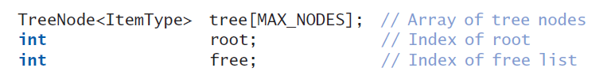
Array-Based Representation (1 of 4)
Class of array-based data members
Variable root is index to tree’s root node within the array tree
If tree is empty, root = −1

Slide 4
Array-Based Representation (2 of 4)
As tree changes (additions, removals) …
Nodes may not be in contiguous array elements
Thus, need list of available nodes
Called a free list
Node removed from tree
Placed in free list for later use

Slide 5
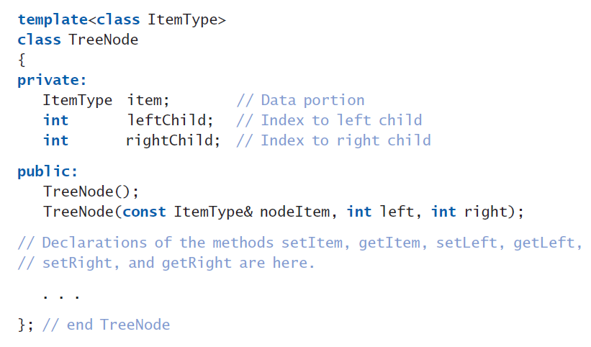
Array-Based Representation (3 of 4)
Listing 16-1 The class TreeNode for an array-based implementation of the A D T binary tree

Slide 6
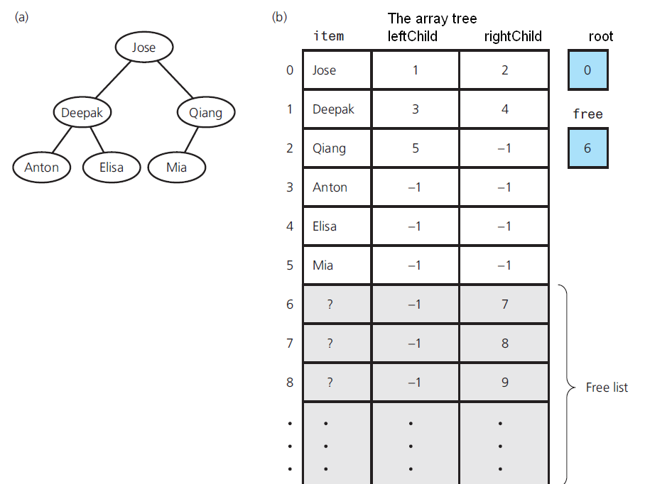
Array-Based Representation (4 of 4)
Figure 16-1 (a) A binary tree of names; (b) Its implementation using the array tree

Slide 7
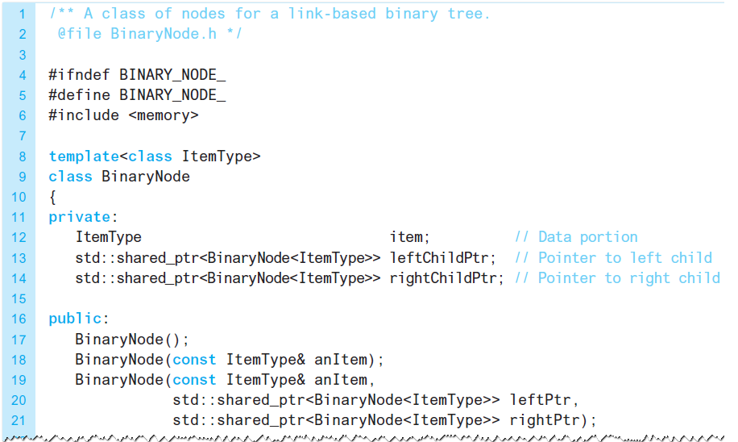
Link-Based Representation (1 of 3)
Listing 16-2 The header file containing the class BinaryNode for a link-based implementation of the A D T binary tree

Slide 8
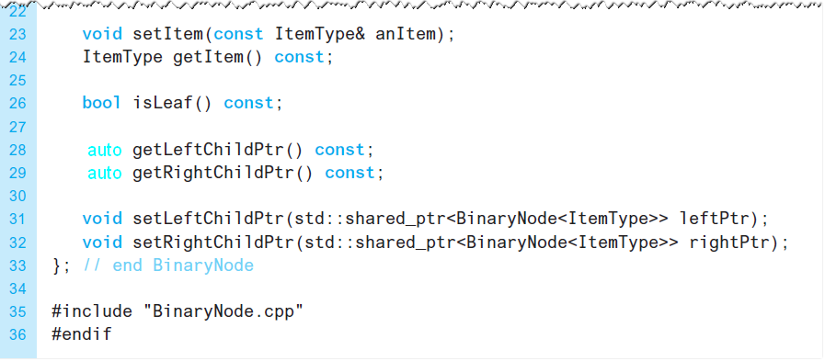
Link-Based Representation (2 of 3)
Listing 16-2 [Continued]

Slide 9
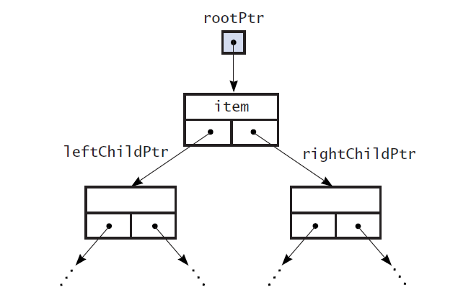
Link-Based Representation (3 of 3)
Figure 16-2 A link-based implementation of a binary tree

Slide 10
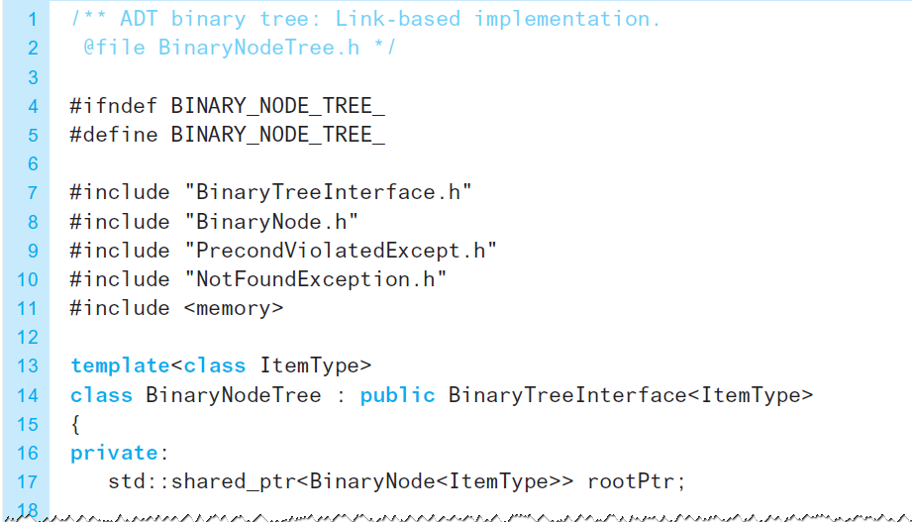
The Header File (1 of 6)
Listing 16-3 A header file for the link-based implementation of the class BinaryNodeTree

Slide 11
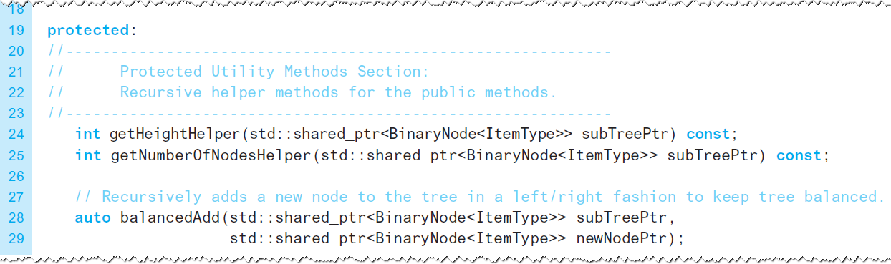
The Header File (2 of 6)
Listing 16-3 [Continued]

Slide 12
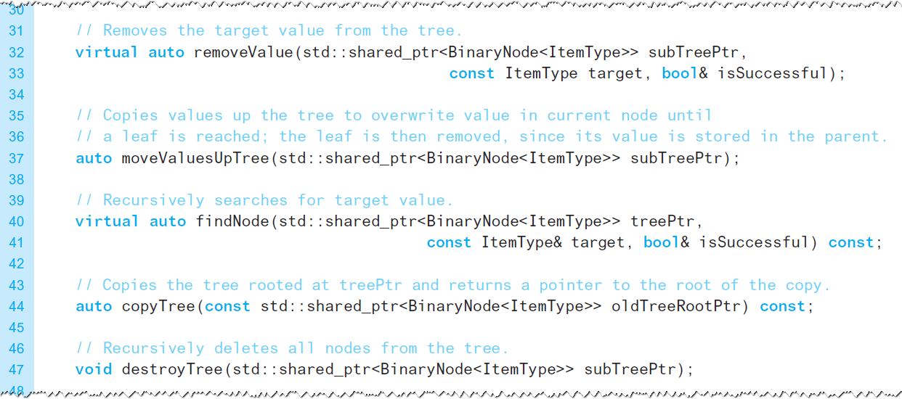
The Header File (3 of 6)
Listing 16-3 [Continued]

Slide 13
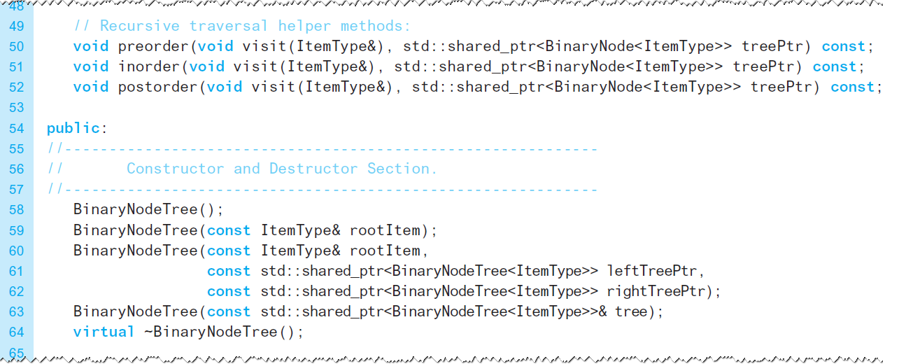
The Header File (4 of 6)
Listing 16-3 [Continued]

Slide 14
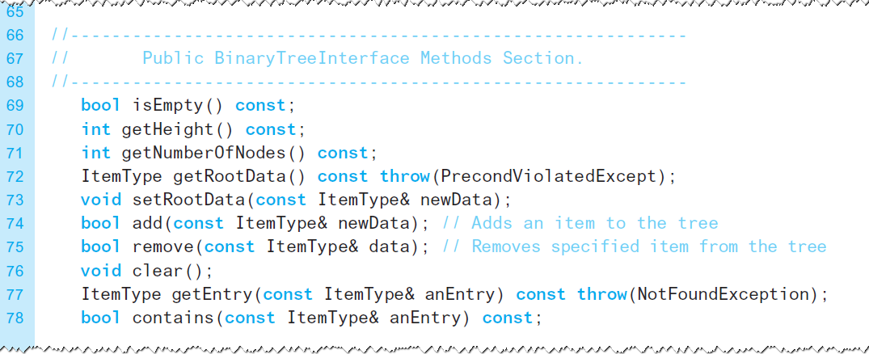
The Header File (5 of 6)
Listing 16-3 [Continued]

Slide 15
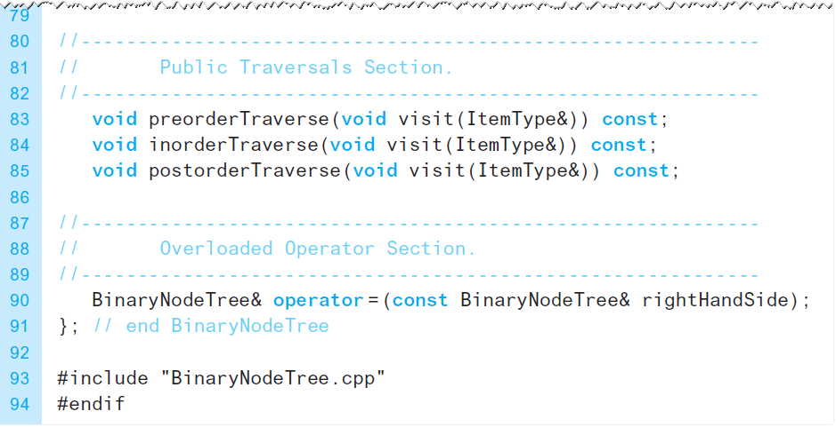
The Header File (6 of 6)
Listing 16-3 [Continued]

Slide 16
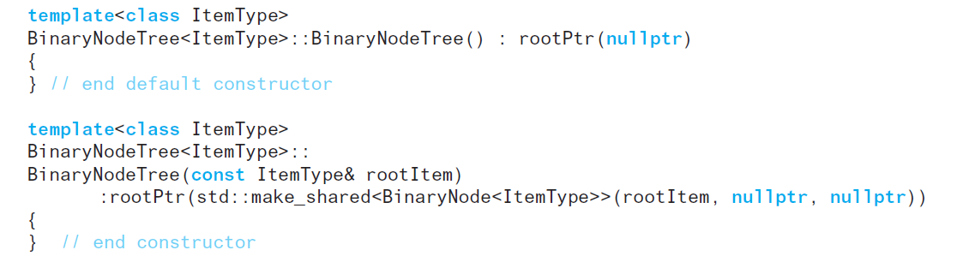
The Implementation (1 of 16)
Constructors

Slide 17
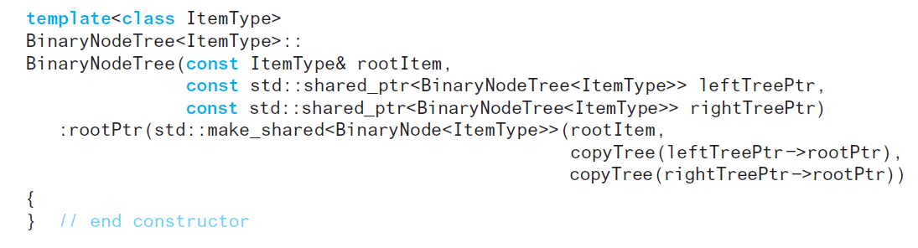
The Implementation (2 of 16)
Constructors

Slide 18
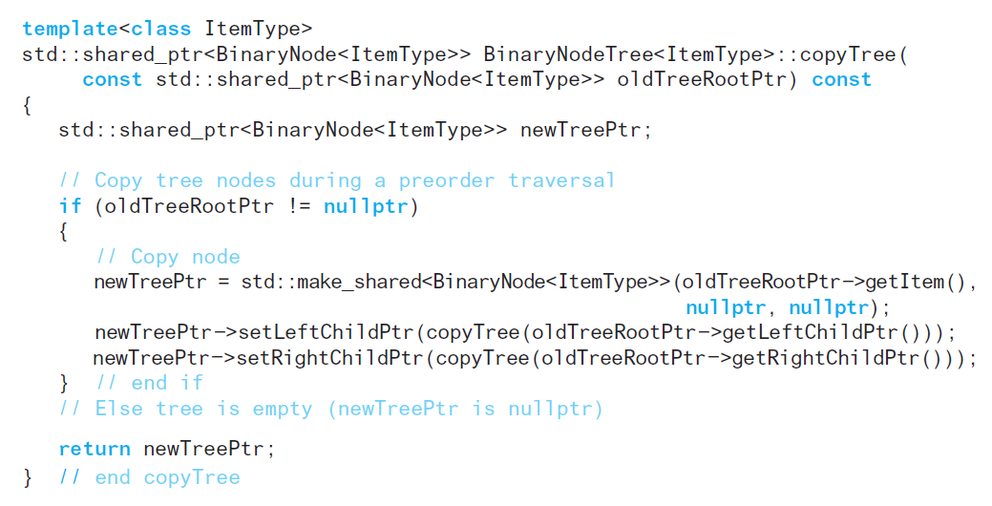
The Implementation (3 of 16)
Protected method copyTree called by copy constructor

Slide 19
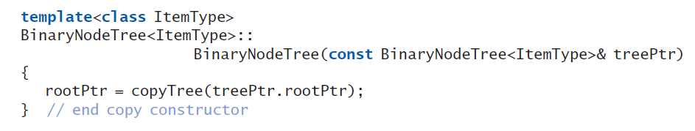
The Implementation (4 of 16)
Copy constructor

Slide 20
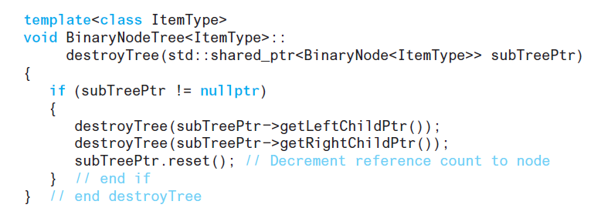
The Implementation (5 of 16)
destroyTree used by destructor which simply calls this method

Slide 21
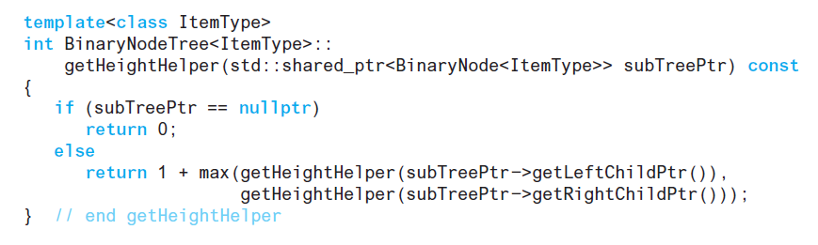
The Implementation (6 of 16)
Protected method getHeightHelper

Slide 22
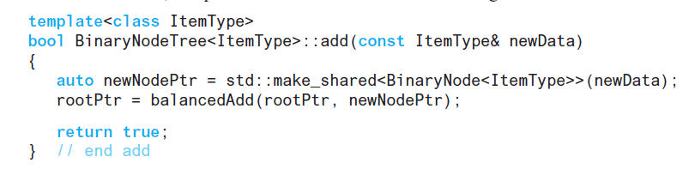
The Implementation (7 of 16)
Method add

Slide 23
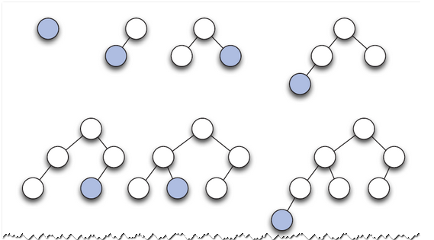
The Implementation (8 of 16)
Figure 16-3 Adding nodes to an initially empty binary tree

Slide 24
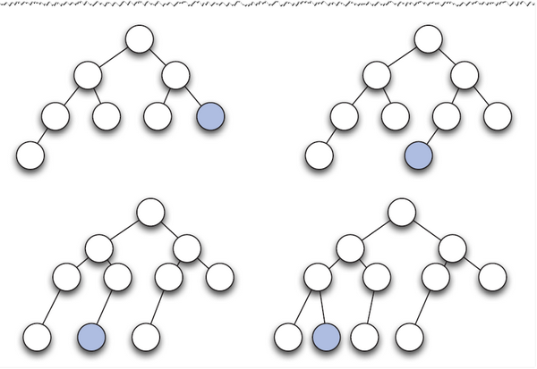
The Implementation (9 of 16)
Figure 16-3 [Continued]

Slide 25
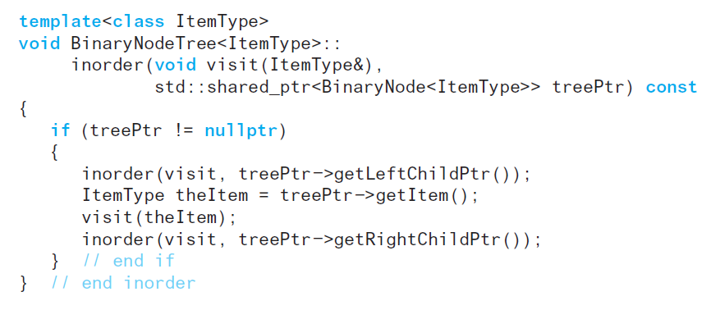
The Implementation (10 of 16)
Protected method that enables recursive traversals.

Slide 26
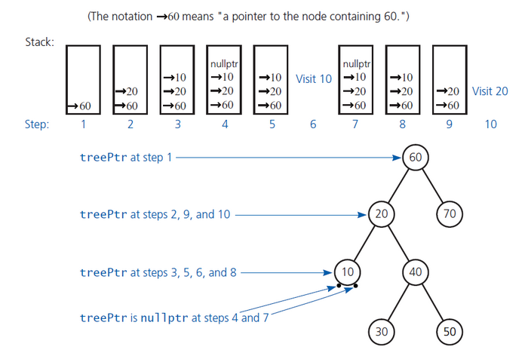
The Implementation (11 of 16)
Figure 16-4 Contents of the implicit stack as tree P t r progresses through a given tree during a recursive inorder traversal

Slide 27
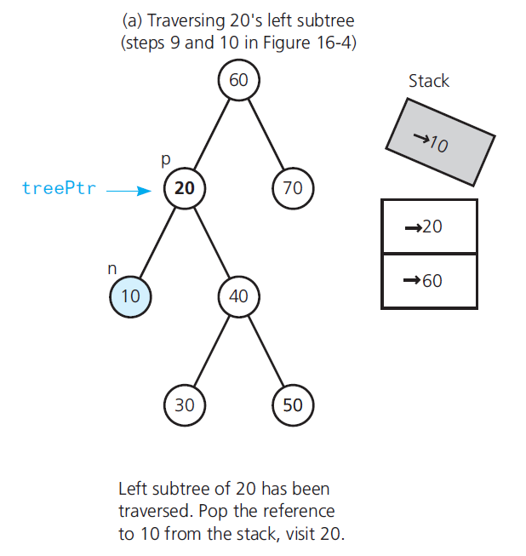
The Implementation (12 of 16)
Figure 16-5 Steps during an inorder traversal of the subtrees of 20

Slide 28
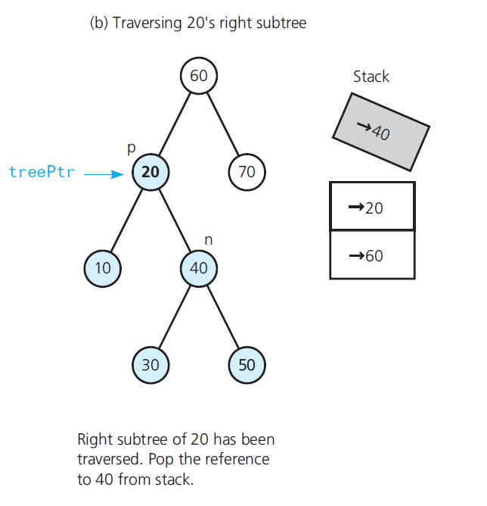
The Implementation (13 of 16)
Figure 16-5 [Continued]

Slide 29
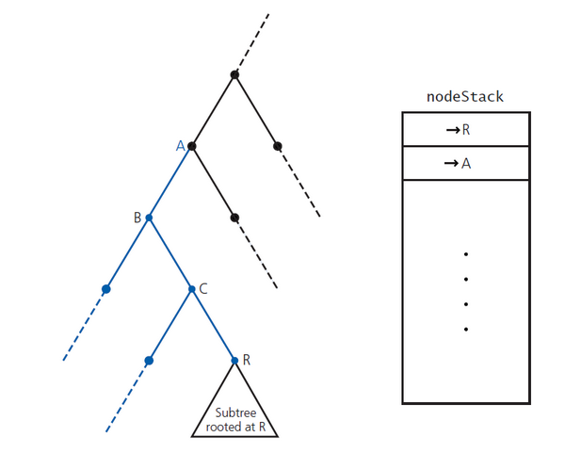
The Implementation (14 of 16)
Figure 16-6 Avoiding returns to nodes B and C

Slide 30
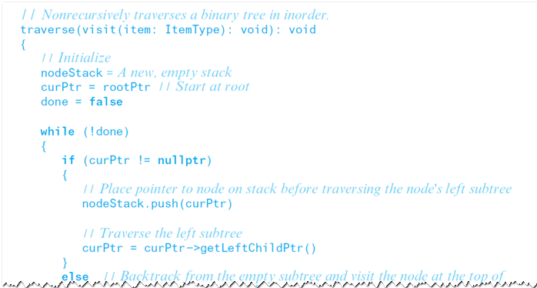
The Implementation (15 of 16)
Nonrecursive inorder traversal

Slide 31
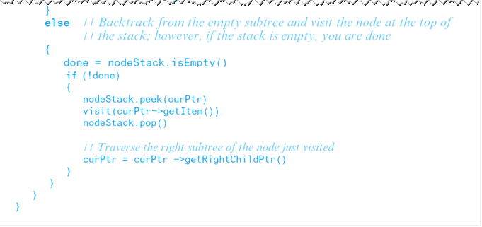
The Implementation (16 of 16)
Nonrecursive inorder traversal

Slide 32
Link-Based Implementation of the A D T Binary Search Tree (1 of 26)
Uses same node objects as for binary-tree implementation.
Class BinaryNode from Listing16-2 will be used
Recursive search algorithm from Section15.3.2 is basis for operations

Slide 33
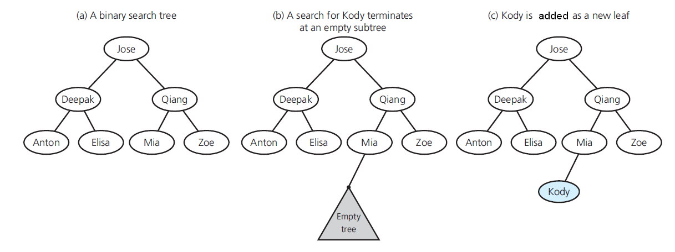
Link-Based Implementation of the A D T Binary Search Tree (2 of 26)
Figure 16-7 Adding Kody to a binary search tree

Slide 34
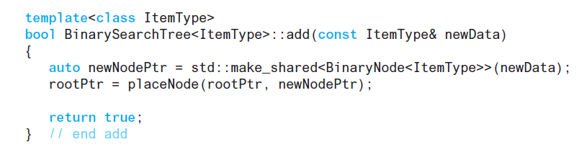
Link-Based Implementation of the A D T Binary Search Tree (3 of 26)
Method add

Slide 35
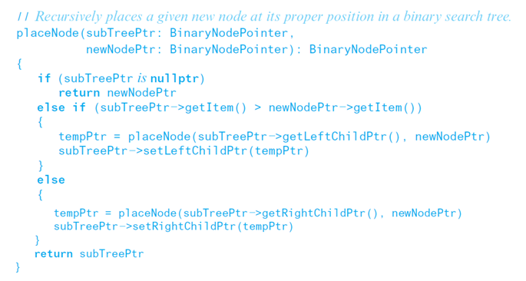
Link-Based Implementation of the A D T Binary Search Tree (4 of 26)
Refinement of addition algorithm

Slide 36
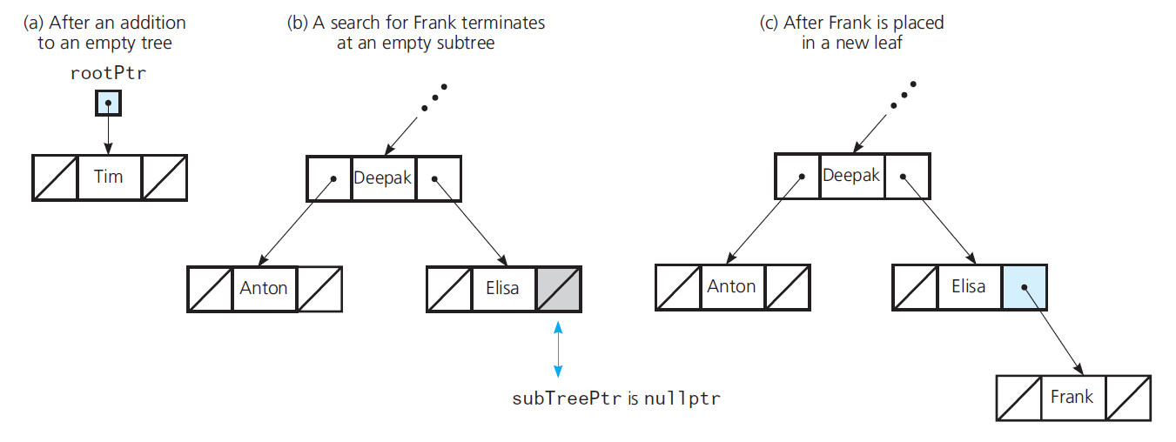
Link-Based Implementation of the A D T Binary Search Tree (5 of 26)
Figure 16-8 Adding new data to a binary search tree

Slide 37
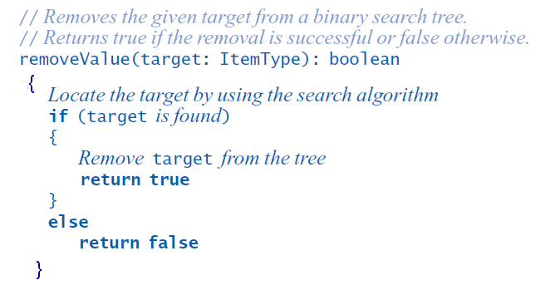
Link-Based Implementation of the A D T Binary Search Tree (6 of 26)
First draft of the removal algorithm

Slide 38
Link-Based Implementation of the A D T Binary Search Tree (7 of 26)
Cases for node N containing item to be removed
N is a leaf
Remove leaf containing target
Set pointer in parent to null p t r

Slide 39
Link-Based Implementation of the A D T Binary Search Tree (8 of 26)
Cases for node N containing item to be removed
N has only left (or right) child – cases are symmetrical
After N removed, all data items rooted at L (or R) are adopted by root of N
All items adopted are in correct order, binary search tree property preserved

Slide 40
Link-Based Implementation of the A D T Binary Search Tree (9 of 26)
Cases for node N containing item to be removed
N has two children
Locate another node M easier to remove from tree than N
Copy item that is in M to N
Remove M from tree

Slide 41
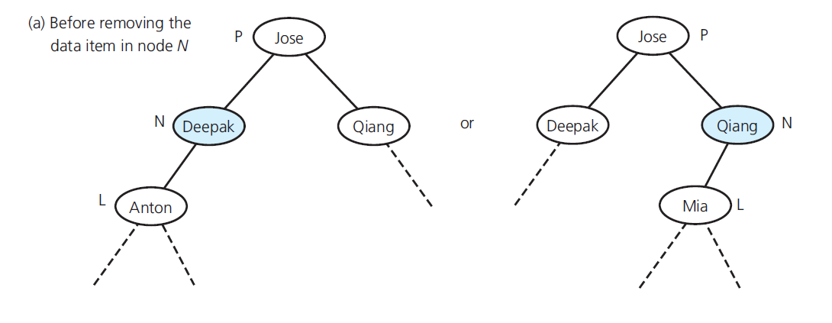
Link-Based Implementation of the A D T Binary Search Tree (10 of 26)
Figure 16-9 Case 2 for removeValue: The data item to remove is in a node N that has only a left child and whose parent is node P

Slide 42
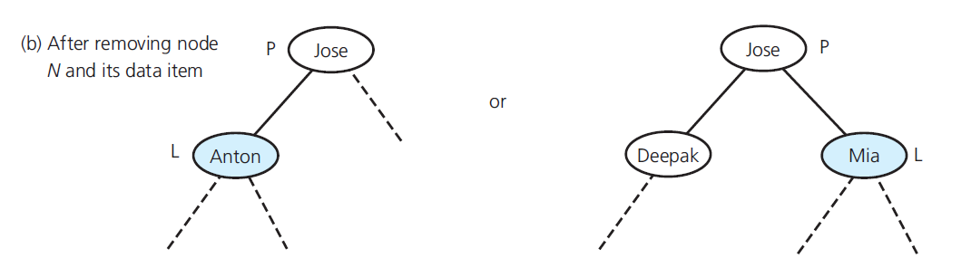
Link-Based Implementation of the A D T Binary Search Tree (11 of 26)
Figure 16-9 [Continued]

Slide 43
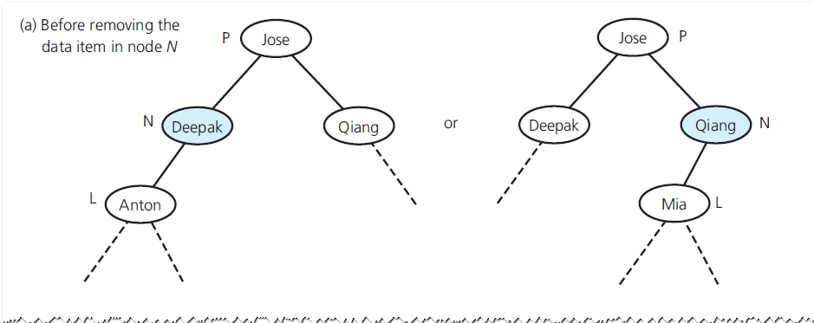
Link-Based Implementation of the A D T Binary Search Tree (12 of 26)
Figure 16-9 [Continued]

Slide 44
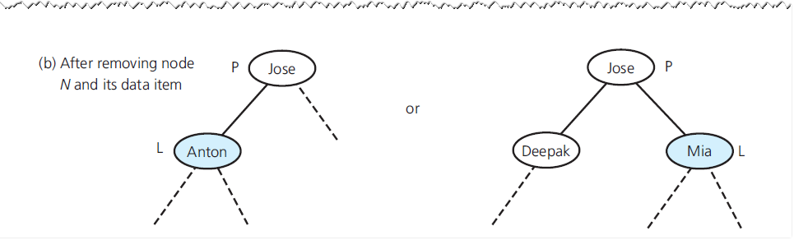
Link-Based Implementation of the A D T Binary Search Tree (13 of 26)
Figure 16-9 [Continued]

Slide 45
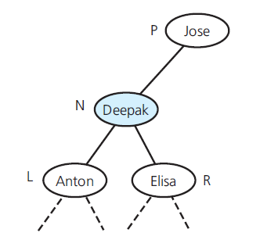
Link-Based Implementation of the A D T Binary Search Tree (14 of 26)
Figure 16-10 Case 3: The data item to remove is in a node N that has two children

Slide 46
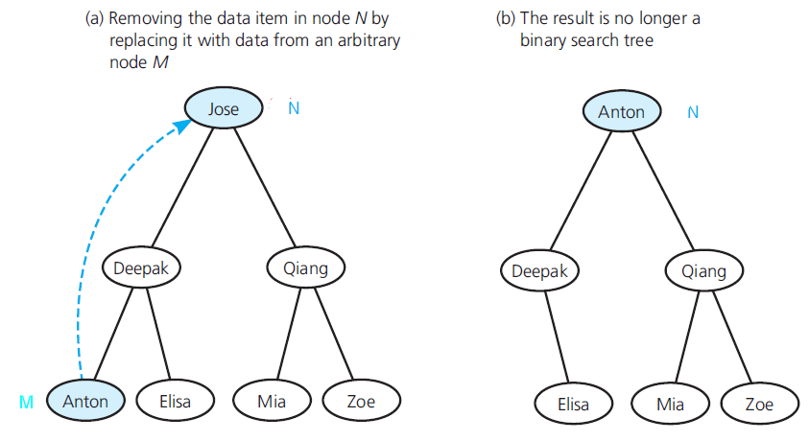
Link-Based Implementation of the A D T Binary Search Tree (15 of 26)
Figure16-11 Not any node will do

Slide 47
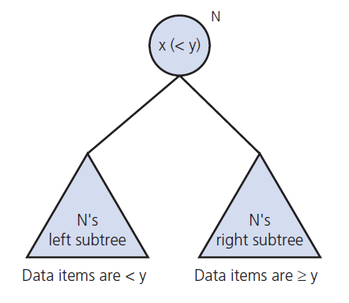
Link-Based Implementation of the A D T Binary Search Tree (16 of 26)
Figure 16-12

Slide 48
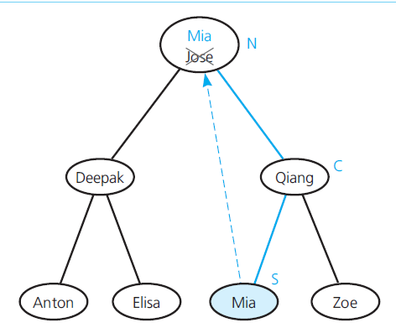
Link-Based Implementation of the A D T Binary Search Tree (17 of 26)
Figure 16-13 Replacing the data item in node N with its inorder successor

Slide 49
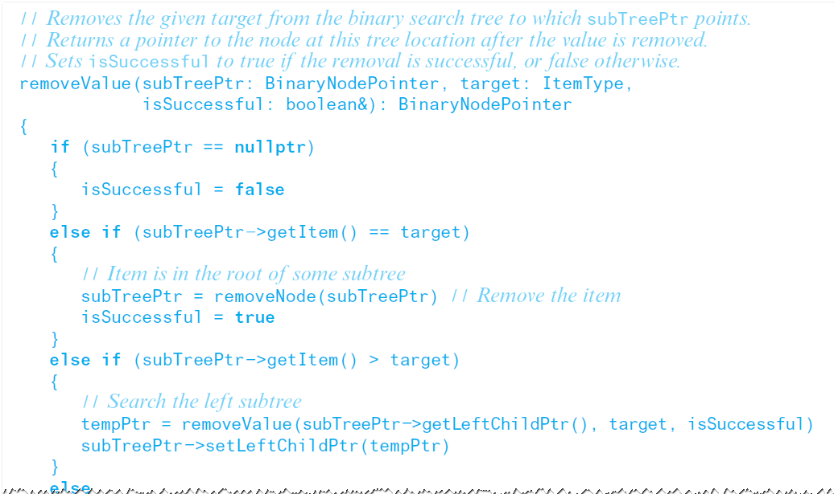
Link-Based Implementation of the A D T Binary Search Tree (18 of 26)
Final draft of the removal algorithm

Slide 50
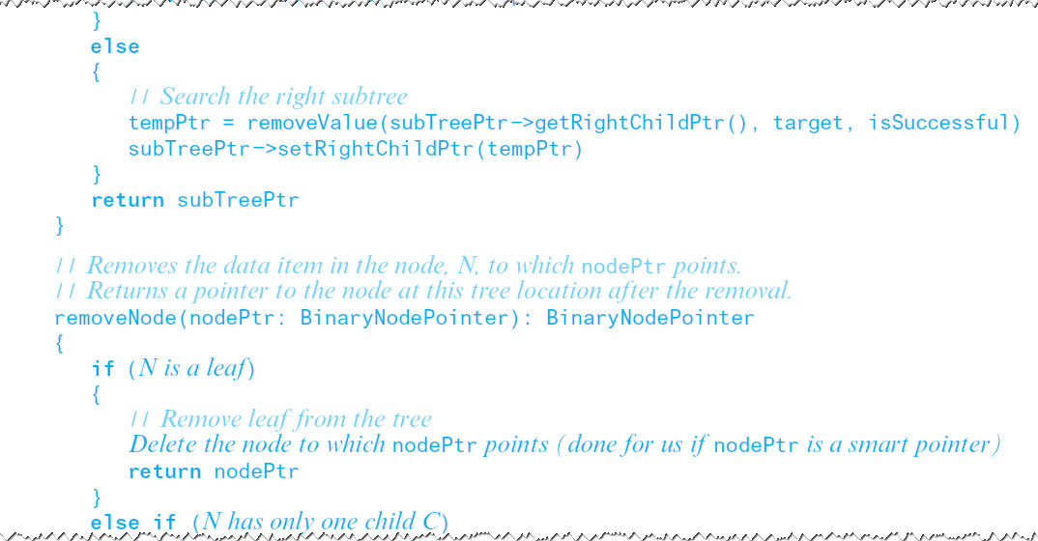
Link-Based Implementation of the A D T Binary Search Tree (19 of 26)
Final draft of the removal algorithm

Slide 51
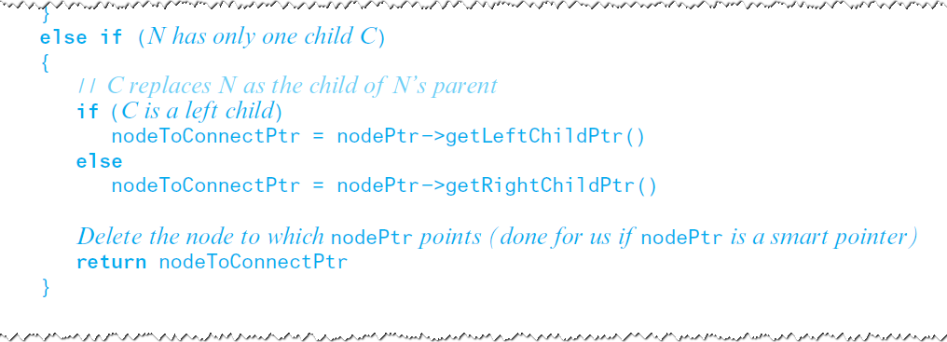
Link-Based Implementation of the A D T Binary Search Tree (20 of 26)
Final draft of the removal algorithm

Slide 52
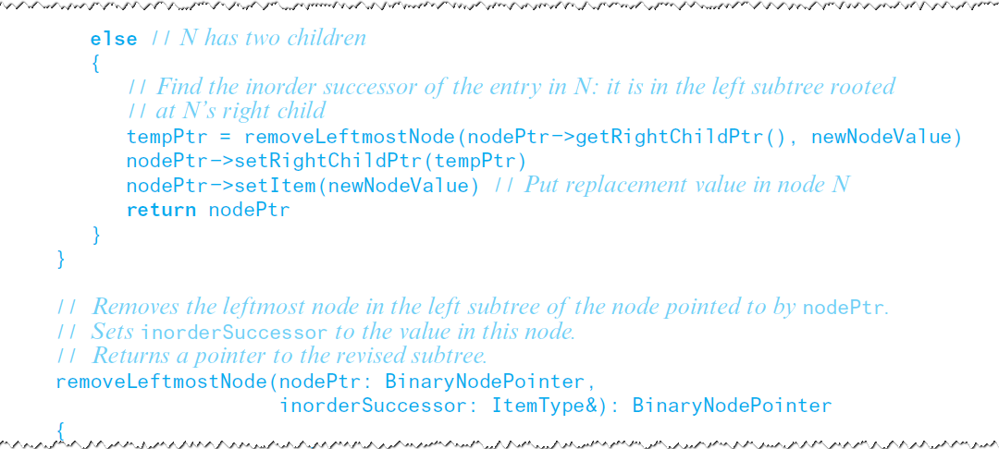
Link-Based Implementation of the A D T Binary Search Tree (21 of 26)
Final draft of the removal algorithm

Slide 53
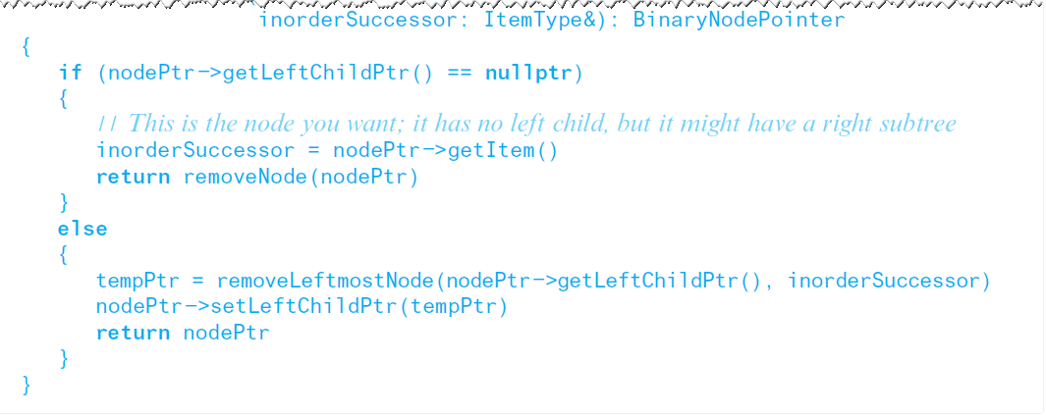
Link-Based Implementation of the A D T Binary Search Tree (22 of 26)
Final draft of the removal algorithm

Slide 54
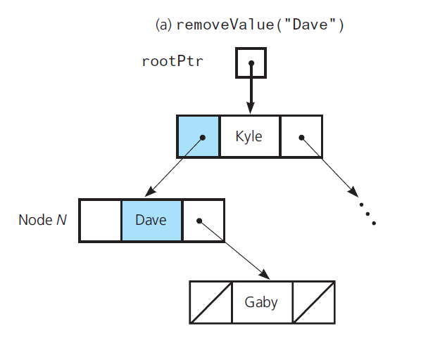
Link-Based Implementation of the A D T Binary Search Tree (23 of 26)
Figure 16-14 Recursive removal of node N

Slide 55
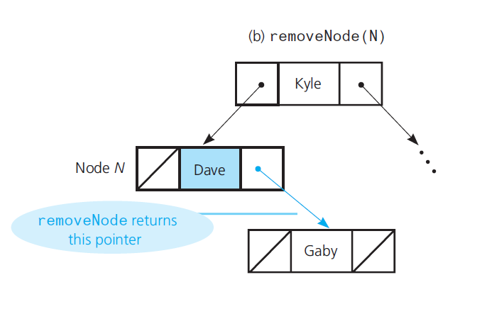
Link-Based Implementation of the A D T Binary Search Tree (24 of 26)
Figure 16-14 [Continued]

Slide 56
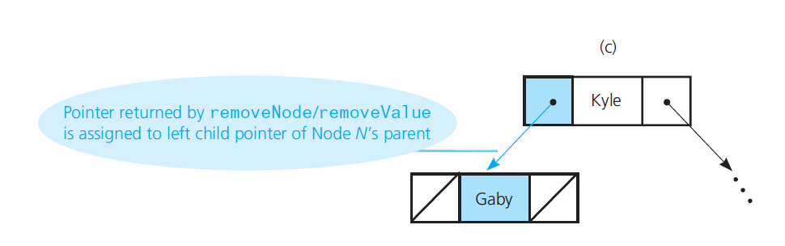
Link-Based Implementation of the A D T Binary Search Tree (25 of 26)
Figure 16-14 [Continued]

Slide 57

Link-Based Implementation of the A D T Binary Search Tree (26 of 26)
Algorithm for findNode

Slide 58

The Class BinarySearchTree (1 of 5)
Listing 16-4 A header file for the link-based implementation of the class BinarySearchTree

Slide 59

The Class BinarySearchTree (2 of 5)
Listing 16-4 [Continued]

Slide 60

The Class BinarySearchTree (3 of 5)
Listing 16-4 [Continued]

Slide 61

The Class BinarySearchTree (4 of 5)
Listing 16-4 [Continued]

Slide 62

The Class BinarySearchTree (5 of 5)
Listing 16-4 [Continued]

Slide 63

Saving a Binary Search Tree in a File (1 of 6)
Figure 16-15 An initially empty binary search tree after the addition of 60, 20, 10, 40, 30, 50, and 70

Slide 64
Saving a Binary Search Tree in a File (2 of 6)
Use preorder traversal to save binary search tree in a file
Restore to original shape by using method add
Balanced binary search tree increases efficiency of A D T operations

Slide 65

Saving a Binary Search Tree in a File (3 of 6)
Figure 16-16 A full tree saved in a file by using inorder traversal

Slide 66

Saving a Binary Search Tree in a File (4 of 6)
Figure 16-17 A tree of minimum height that is not complete

Slide 67

Saving a Binary Search Tree in a File (5 of 6)
Building a minimum-height binary search tree

Slide 68

Saving a Binary Search Tree in a File (6 of 6)
Building a minimum-height binary search tree

Slide 69

Tree Sort
Tree sort uses a binary search tree.

Slide 70

General Trees (1 of 3)
Figure 16-18 A general tree or an n-ary tree with n = 3

Slide 71

General Trees (2 of 3)
Figure 16-19 An implementation of a general tree and its equivalent binary tree

Slide 72

General Trees (3 of 3)
Figure 16-20 An implementation of the n-ary tree in Figure 16-18(see slide 70)

Slide 73

Copyright

